Slide 1


Dictionaries
Module 1. Lesson 3.
Dictionary

Slide 2

Module 1. Lesson 3. Dictionaries
The library of the
A's for All school

Slide 3


You have been assigned a new order!
The director of the school praised the technical solutions from the ProTeam development team.
Now the school library has asked for help since its book catalog has needed to be digitized for a long time.
The new order includes programs for the following:
a catalog to locate books in the library;
the display of reference information about books;
book recommendations by author, etc.
Ready to get started?
Discussing
work tasks
Cole,
senior developer

Slide 4
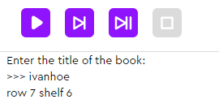
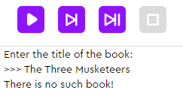
Let’s look at a typical task
The task. Write a program that asks for the title of a book and displays its location in the library's repository. If that book isn’t there, it displays: "There is no such book!"
Discussing
work tasks
If a book with that title is found, display its location
If there is no such book, display: "There is no such book!"
How do we write such a program?

Slide 5
Let’s look at a typical task
The task. Write a program that asks for the title of a book and displays its location in the library's repository. If that book isn’t there, it displays: "There is no such book!"
Method 1. Using a conditional statement
Advantages:
The simplicity of the solution.
Disadvantages:
Program size.
What if there are 100 books? 5,000?
The speed of operation
(a lot of needless checks if there is no such book).
If the library receives new books, the program will need to be changed.
title = input('Enter the title of the book:')
title = title.lower()
if title == 'ivanhoe':
print('row 7 shelf 6')
elif title == 'nicholas nickelby':
print('row 1 shelf 2')
elif title == 'oliver twist':
print('row 10 shelf 3')
# ...
else:
print('There is no such book!')
Discussing
work tasks0

Slide 6
Let’s look at a typical task
The task. Write a program that asks for the title of a book and displays its location in the library's repository. If that book isn’t there, it displays: "There is no such book!"
Method 2. Using a list
Advantages:
If new books arrive, they can easily be added to the database.
Program size.
Disadvantages:
Strict compliance with the numbers in the list must be maintained. If you delete a book and forget to delete the location, the whole base will break.
0 | 1 | 2
oliver twist | nicholas nickelby | ivanhoe
Discussing
work tasks
0 | 1 | 2
row 10 shelf 3 | row 1 shelf 2 | row 7 shelf 6

Slide 7
Let’s look at a typical task
The task. Write a program that asks for the title of a book and displays its location in the library's repository. If that book isn’t there, it displays: "There is no such book!"
title = input('Enter the title of the book:')
title = title.lower()
books = ['oliver twist', 'nicholas nickelby',’xyz’]
addresses = ['row 10 shelf 3', 'row 1 shelf 2']
if title in books:
for i in range(len(books)):
if books[i] == title:
print('Book location:', addresses[i])
else:
print('There is no such book!')
Method 2. Using a list
Advantages:
If new books arrive, they can easily be added to the database.
Program size.
Disadvantages:
Strict compliance with the numbers in the list must be maintained. If you delete a book and forget to delete the location, the whole base will break.
Discussing
work tasks

Slide 8
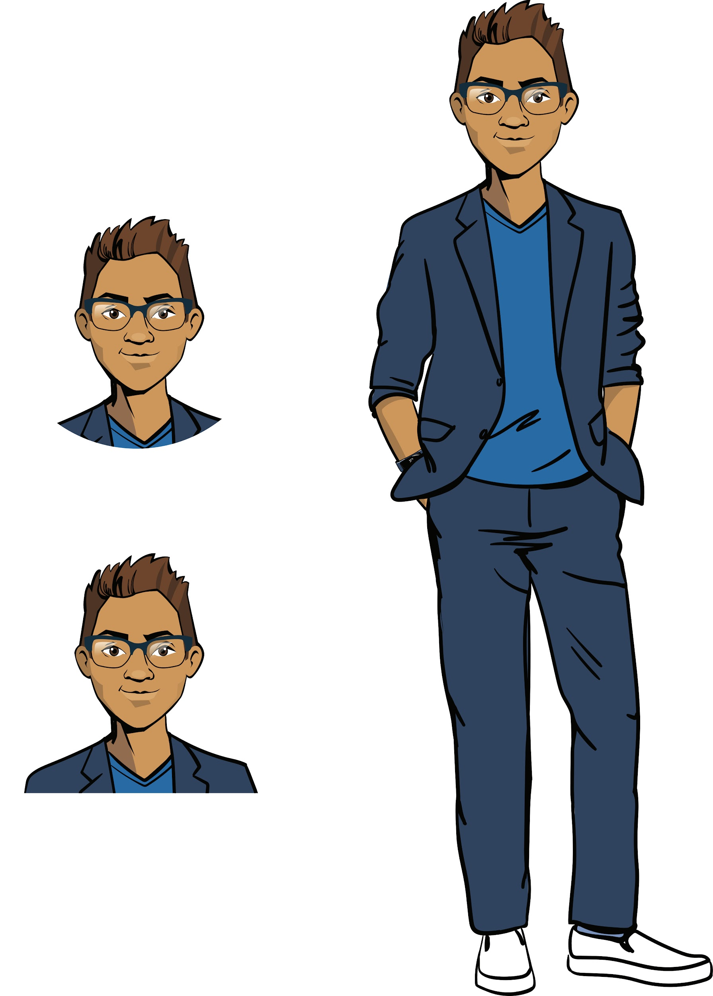
Let’s look at a typical task
The task. Write a program that asks for the title of a book and displays its location in the library's repository. If that book isn’t there, it displays: "There is no such book!"
Method 3. Using a dictionary
Python has a special structure for storing pairs of items — a dictionary. It allows you to match items without having corresponding numbers.
Discussing
work tasks
oliver twist | nicholas nickelby | ivanhoe
row 10 shelf 3 | row 1 shelf 2 | row 7 shelf 6
Cole,
senior developer

Slide 9
Let’s look at a typical task
The task. Write a program that asks for the title of a book and displays its location in the library's repository. If that book isn’t there, it displays: "There is no such book!"
books = {
'oliver twist': 'row 10 shelf 3',
'nicholas nickelby': 'row 1 shelf 2'
}
title = input('Enter the title of the book:')
title = title.lower()
if title in books:
print('Book location:', books[title])
else:
print('There is no such book!')
Method 3. Using a dictionary
Advantages:
The simplicity of the solution.
The speed of operation.
Data is easily added and removed.
Disadvantages:
Need to learn new data structure.
Discussing
work tasks

Slide 10
The goal of the work day is
to study a new data structure, dictionaries, and use it to fulfill an order to digitize the catalog of a school library.
Today you will
Discussing
work tasks
go through another stage of qualifications for the position of a Python developer;
program a digital book catalog;
learn a new and apply it in the implementation of the new order.

Slide 11

Module 1. Lesson 3. Dictionaries
Qualifications

Slide 12
Demonstrate your knowledge
of lists and methods of working
with them.
Qualifications

Slide 13
What is a list?
How do we create a list?
How do we get an item from a list?
Qualifications

Slide 14
A list is a structure for the ordered storage of data of different types.
results = list()
results = [181, 181, 160, 178, 171, 179, 165]
181 | 181 | 160 | 178 | 171 | 179 | 165
0 | 1 | 2 | 3 | 4 | 5 | 6
Qualifications
print(‘Best result:’, results[5])
Best result: 181
Getting a list item by its number (index)
The program displays

Slide 15
Fill in the gaps with methods
and their purposes
Suppose there is a list:
students = [‘Smith’, ‘Williams’, ‘Holmes’]
Add the last name ‘Hudson’ to the list
?
Qualifications
?
students.remove(‘Williams’)
?
‘Anderson’ in students
Sort the list
alphabetically
?

Slide 17
Fill in the gaps with methods
and their purposes
Suppose there is a list:
students = [‘Smith’, ‘Williams’, ‘Holmes’]
Add the last name ‘Hudson’ to the list
students.append(‘Hudson’)
Qualifications
Remove the last name ‘Williams’ from the list
students.remove(‘Williams’)
Determine if the last name ‘Anderson’ is in the list
‘Anderson’ in students
Sort the list
alphabetically
students.sort()

Slide 18
Name the commands that were
applied to this list.
Suppose there is a list:
marks = [5, 4, 5, 3, 5]
HERE
[3, 4, 5, 5, 5]
HERE
[5, 4, 5, 3, 5, 5, 5]
Qualifications
?
Output:
5
5
5

Slide 19
Name the commands that were
applied to this list.
Suppose there is a list:
marks = [5, 4, 5, 3, 5]
marks.sort()
[3, 4, 5, 5, 5]
[5, 4, 5, 3, 5, 5, 5]
Qualifications
marks.append(5)
marks.append(5)
or
marks + [5, 5]
for mark in marks:
if mark == 5:
print(mark)
Output:
5
5
5

Slide 20
Formulate an idea for solving the problem
The task. Write a program that asks for a random grades separated by spaces and displays the number of F.
Qualifications
How do we write such a program?

Slide 21
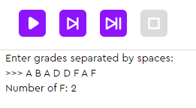
Optimal solution
The task. Write a program that asks for a random grades separated by spaces and displays the number of F.
marks = input('Enter grades separated by spaces:')
marks_list = marks.split(' ')
amount_f = 0
for mark in marks_list:
if mark == 'F':
amount_f += 1
print('Number of F:', amount_f)
[“A”,”B”....]
Qualifications
this is a method that splits a string into parts according to a specified separator. A list is made from the those parts.
marks_list = marks.split(‘ ’)

Slide 22
Qualifications confirmed!
Great, you are ready for brainstorming and completing your work tasks!
Qualifications

Slide 23

Module 1. Lesson 3. Dictionaries
Brainstorming:
The library of the
A's for All school

Slide 24
Planning work tasks
In general, all the tasks for the library come down to organizing the storage of pairs of the following items:
book — author,
book — location,
school subject — textbooks,
genre — writers, etc.
Library readers should be able to do the following:
get a book recommendation by genre,
find out the location of a book by its title,
get a list of textbooks for a specific subject, etc.
Brainstorming
Cole,
senior developer

Slide 25
Planning work tasks
In general, all the tasks for the library come down to organizing the storage of pairs of the following items:
book — author,
book — location,
school subject — textbooks,
genre — writers, etc.
Library readers should be able to do the following:
get a book recommendation by genre,
find out the location of a book by its title,
get a list of textbooks for a specific subject, etc.
We’ll organize this data storage
using dictionaries
Brainstorming
Cole,
senior developer

Slide 26
A dictionary is an unordered set of key-value pairs.
Dictionary declaration:
books = dict()
books = {'poem': 'Romeo and Juliet', 'fairy tale': 'nicholas nickelby'}
Key
Value
Key
Value
Brainstorming
Getting an item by key: (Dictionary Key Unlocks a Value)
genre = input('Enter a genre:') -> poem
print('Recommendation:', books[genre]) ->Romeo and Juliet

Slide 27
A dictionary is an unordered set of key-value pairs.
Example: -> Key : Value
books_amount = {'Treasure Island': 5, 'Moonfleet': 3, 'The Three Musketeers' : 7}
Question | Answer
How many pairs are in the dictionary? | ?
List all the keys | ?
List all the values | ?
How many copies of The Three Musketeers are in the library? | ?
Brainstorming

Slide 28
A dictionary is an unordered set of key-value pairs.
Example:
books_amount = {'Treasure Island': 5, 'Moonfleet': 3, 'The Three Musketeers' : 7, “World Atlas”: 5}
Question | Answer | Command
How many pairs are in the dictionary? | 4 | len(books_amount)
List all the keys | 'Treasure Island', 'Moonfleet', 'The Three Musketeers' | print(books_amount.keys())
List all the values | 5, 3, 7 | books_amount.values()
How many copies of The Three Musketeers are in the library? | 7 | books_amount['The Three Musketeers']
Brainstorming

Slide 29
To implement a digital catalog project, you need to be able to solve tasks:
Data structure creation and information extraction
Create a dictionary
Get an item by key
Display an entire dictionary, all keys, or all values
Adding new data and deleting unnecessary data
Add and delete keys
Change the value of a key
Brainstorming
Sorting and searching for specific data
Check for a key
Sort a dictionary in a for loop

Slide 30
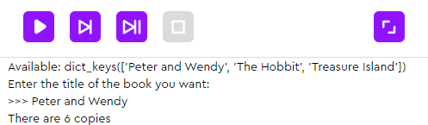
Planning work tasks
Task 1а. Write a program to check if a book is in the library. The program should do the following:
Display a list of all the books and ask for the title of a book.
Determine if there is such a book. If so, display the number of copies remaining. If not, display an error message.
Example of such a program:
Brainstorming
What tools will we need to create the program?

Slide 31
Planning work tasks
Task 1а. Write a program to check if a book is in the library. The program should do the following:
Display a list of all the books and ask for the title of a book.
Determine if there is such a book. If so, display the number of copies remaining. If not, display an error message.
We need these tools:
Function | Purpose
books = dict() books = {‘Primer’: 18} | Declaring an empty dictionary Declaring a dictionary with a key
books[’JK Rowling’] = 5 | Adding key-value pairs
print(books) | Displaying the entire dictionary
‘A Christmas Carol’ in books | Finding an occurrence of an item in a list (it returns True or False)
Brainstorming

Slide 32
Planning work tasks
Task 1а. Write a program to check if a book is in the library. The program should do the following:
Display a list of all the books and ask for the title of a book.
Determine if there is such a book. If so, display the number of copies remaining. If not, display an error message.
books = {'Peter Pan': 6, 'The Hobbit': 8, 'Treasure Island' : 4}
print('Available:', books.keys())
wish = input('Enter the title of the book you want:') <- Peter Pan
if wish in books:
print('There are', books[wish], 'copies')
else:
print('Book not found')
Brainstorming

Slide 33
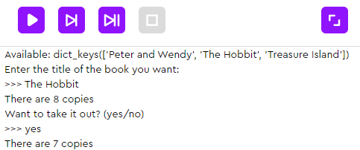
Planning work tasks
Task 1b. Supplement the previous program with the ability to take a book from the repository. The program should now do the following:
Prompt for a response to the question: "Want to take it out?"
If yes, reduce the number of available books.
Example of such a program:
Brainstorming
What tools that we know could come in handy to build the program?

Slide 34
Planning work tasks
Task 1b. Supplement the previous program with the ability to take a book from the repository. The program should now do the following:
Prompt for a response to the question: "Do you want to take it out?"
If yes, reduce the number of available books.
books = {'Peter Pan': 6, 'The Hobbit':4 , 'Treasure Island' : 4}
print('Available:', books.keys())
wish = input('Enter the title of the book you want:') <- The Hobbit
if wish in books:
print('There are', books[wish], 'copies')
take = input('Do you want the book? yes/no?')
if take == 'yes':
books[wish] -= 1
print('There are', books[wish], 'copies')
else:
print('Book not found')
Brainstorming
Changing the value corresponding to the key

Slide 35
Planning work tasks
Task 2. Write a program to recommend a book by genre:
A list of available genres is displayed. The user then asks for the genre they want.
If the genre they enter is in the list, the title of the corresponding book is displayed. Otherwise, it’s "Genre not found."
We might need these tools:
Function | Purpose
books[‘thrillers’] | Returns a value from the key-value pair
print(books) | Displaying the entire dictionary
print(books.keys()) | Returns all dictionary keys
print(books.values()) | Returns all dictionary values
len(books) | Length of the dictionary (key-pairs)
Brainstorming

Slide 36
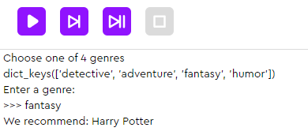
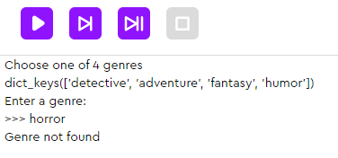
Planning work tasks
Task 2. Write a program to recommend a book by genre:
A list of available genres is displayed. The user then asks for the genre they want.
If the genre they enter is in the list, the title of the corresponding book is displayed. Otherwise, it’s "Genre not found."
Brainstorming
What tools will we need to create the program?

Slide 37
Planning work tasks
Task 2. Write a program to recommend a book by genre:
A list of available genres is displayed. The user then asks for the genre they want.
If the genre they enter is in the list, the title of the corresponding book is displayed. Otherwise, it’s "Genre not found."
books = {
'detective': 'Sherlock Holmes',
'adventure': 'Lord of the Rings',
'fantasy': 'Harry Potter',
'humor': 'Three Men in a Boat'}
print('Choose one of', len(books), 'genres')
genres = books.keys()
print(genres)
genre = input('Enter a genre:').lower()
if genre in books:
print('We recommend:', books[genre])
else:
print('Genre not found')
Sometimes it’s more convenient to write the dictionary like this
Brainstorming

Slide 38
Planning work tasks
Task 2. Write a program to recommend a book by genre:
A list of available genres is displayed. The user then asks for the genre they want.
If the genre they enter is in the list, the title of the corresponding book is displayed. Otherwise, it’s "Genre not found."
Improving the program:
If the desired genre is not found, we will prompt the user to add it and recommend a book in that genre.
Brainstorming
Function | Purpose
books[‘thrillers’] = ‘It’ | Adds a new key-value pair
del books[‘thrillers’] | Removing a key and its value

Slide 39
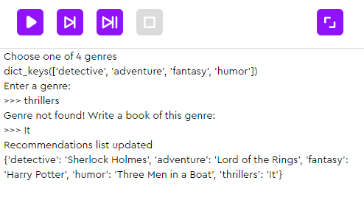
books = {
'detective': 'Sherlock Holmes',
'adventure': 'Lord of the Rings',
'fantasy': 'Harry Potter',
'humor': 'Three Men in a Boat',
}
print('Choose one of', len(books), 'genres')
genres = books.keys()
print(genres)
genre = input('Enter a genre:').lower() <- funny
if genre in books:
print('We recommend:', books[genre])
else:
title = input('Genre not found! Write a book of this genre:')
books[genre] = title
print('Recommendations list updated')
print(books)
Brainstorming

Slide 40
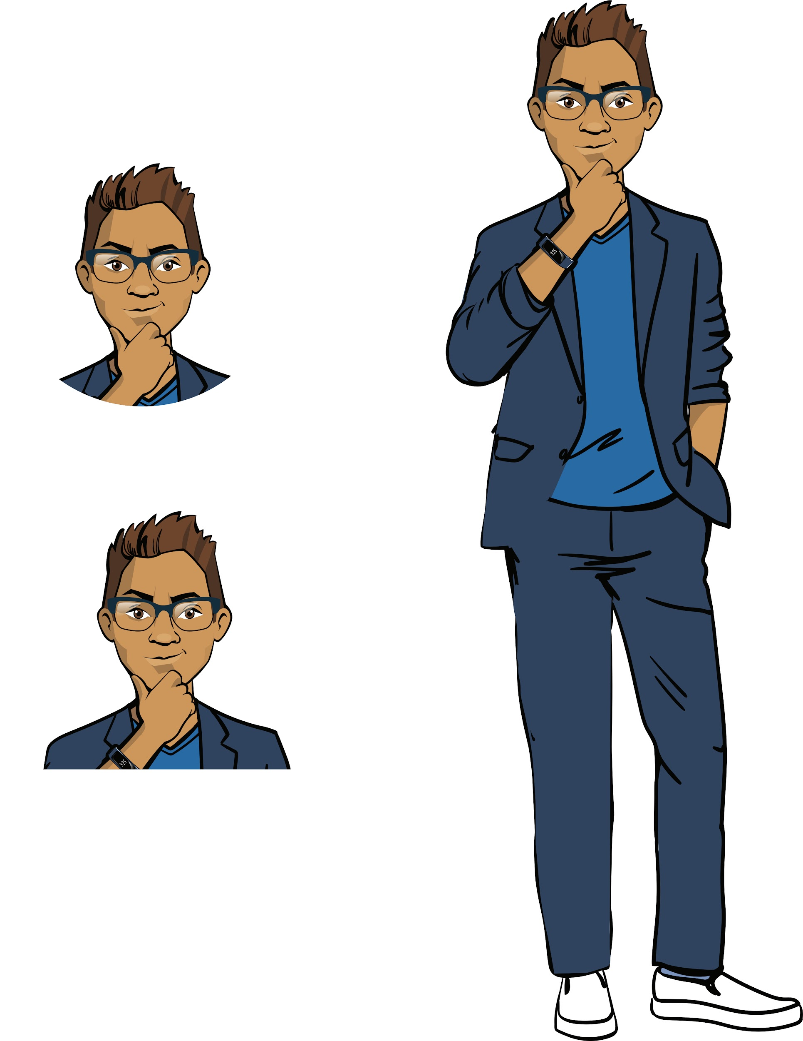
Before proceeding to another task:
What will the previous program display if the user enters "Adventure"? "Tragicomedy"?
How to program an improvement: if the user does not like the recommended book, they enter their own recommendation instead.
Is it possible to sort the contents of the dictionary alphabetically? Why/Why not?
Brainstorming

Slide 41

Module 1. Lesson 3. Dictionaries
Library:
Catalog

Slide 42



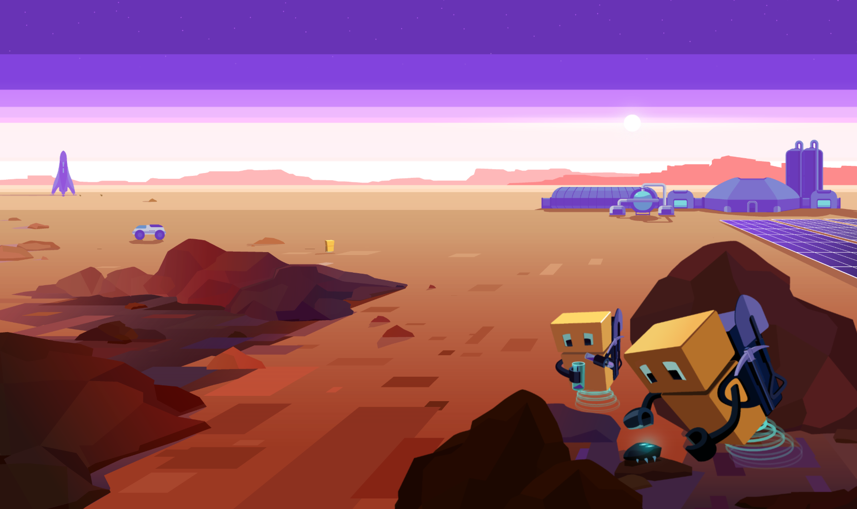
Complete tasks on the platform
Library: catalog
mars.alg.academy
Library:
catalog

Slide 43

Break

Slide 44
Module 1. Lesson 3. Dictionaries
Brainstorming:
The library of the
A's for All school

Slide 45
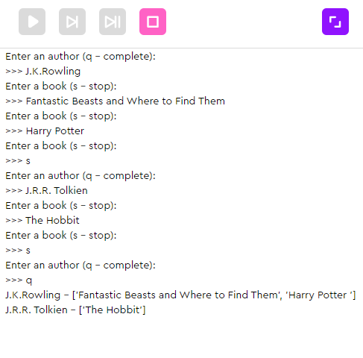
Let’s look at the task
The task. Program the reader's personal shelf. The program should do the following:
Add an author-book pair to the shelf. For this:
request author input;
then books one by one until 's is entered, the books are collected in a list.
Authors stop being added when the user enters 'q'.
Brainstorming
What tools will we need to create the program?

Slide 46
Note:
The number of books is not known in advance. Input is interrupted by the user.
The number of authors is also unknown. Input is interrupted by the user.
Brainstorming
In what data structure would it be convenient to store an author's books?
What about author-book sets?

Slide 47
Let’s look at the task
The task. Program the reader's personal shelf. The program should do the following:
Add an author-book pair to the shelf. For this:
request author input;
then books one by one until 's is entered, the books are collected in a list.
Authors stop being added when the user enters 'q'.
Possible bookshelf structure:
my_shelf = {
Brainstorming
comedy
:
[
Grown Ups
,
Avatar
]
action
:
[
Top Gun
]
Author 3
:
[
Book1
,
Book2
,
Book3
]
}

Slide 48
Possible solution:
my_shelf = dict()
author = input('Enter an author (q - complete):')
while author != 'q':
books = list()
book = input('Enter a book (s - stop):')
while book != 's':
books.append(book)
book = input('Enter a book (s - stop):')
my_shelf[author] = books
author = input('Enter an author (q - complete):')
for author in my_shelf:
print(author, '-', my_shelf[author])
Brainstorming

Slide 49
Before proceeding:
What will the previous program display if the user types “q” right away?
What will the program display if the user enters this data: "Verne", "In Search of the Castaways", "Twenty Thousand Leagues Under the Sea", "s", "q"?
Brainstorming

Slide 50
A dictionary is an unordered set of key-value pairs.
What types of data can be keys and values?
Key | Any immutable data type | String, number, True or False
Value | Any data type | String, number, boolean, list
Brainstorming

Slide 51
A dictionary is an unordered set of key-value pairs.
What types of data can be keys and values?
Key | Any immutable data type | String, number, boolean
Value | Any data type | String, number, boolean, list, dictionary
Brainstorming
Possible: authors[author][2]
authors = {
'Charles Dickens': ['The Song Of The Wreck', 'A Fine Old English Gentleman', 'The Ivy Green'],
'Lewis Carroll': ['Jabberwocky', 'A Tangled Tale', 'Nursery Alice'],
'L.M.Alcott': ['Little Women', 'Jack And Jill', 'Flower Fables']
}

Slide 52
A dictionary is an unordered set of key-value pairs.
What types of data can be keys and values?
Key | Any immutable data type | String, number, boolean
Value | Any data type | String, number, boolean, list, dictionary
Brainstorming
Not possible:
total_books = {
['Childhood', 'Boys', 'Young']: [3, 6, 7],
['Poems', 'Romeo and Juliet']: [1, 3]
}

Slide 53
Before proceeding:
Would it be possible to create a dictionary with the last names of readers and the number of books they’ve checked out (pairs of the "last name-number" type)?
Would it be possible to create a dictionary with the usernames of readers and the dates of their last visit to the library (pairs of the "login-date" type)?
Would it be possible to create a dictionary with people with overdue books by grade and the number of books they’ve checked out (for example, "list of people with overdue books in seventh grade-the number of books")?
If in any of the cases the answer is no, how can the situation be rectified?
Brainstorming

Slide 54
Module 1. Lesson 3. Dictionaries
Library:
Catalog

Slide 55
Complete tasks on the platform
Library: catalog 2
mars.alg.academy
Library:
catalog 2

Slide 56

Module 1. Lesson 3. Dictionaries
End of the
work day

Slide 57

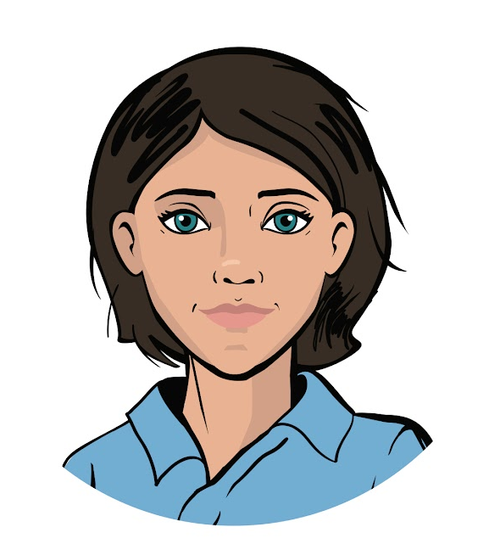
Let’s end the work day by
answering these technical questions
What is a dictionary? What types of data can be items in a dictionary?
What commands for working with dictionaries do you know? What are they for?
Summing up
the work day
Cole,
senior developer
Ann,
project manager

Slide 58

Congratulations on completing the work day!
Today you did the following:
went through skills qualifications for working with lists;
programmed a digital catalog;
got experience using one data structure in another.
Summing up
the work day

Slide 59

Evaluating your performance
Answer these questions with your colleagues:
What turned out the best?
What didn’t turn out the way you wanted?
What should you do next time to avoid any issues?
Summing up
the work day

Slide 60
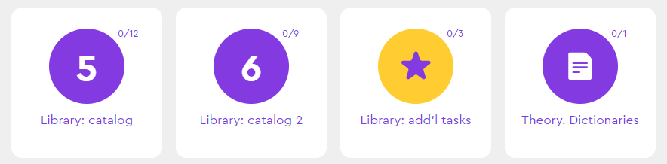
Additional tasks to improve your performance
Library:
add’l tasks
Summing up
the work day

Slide 61
Share projects with other students
Hall of Fame

Slide 62
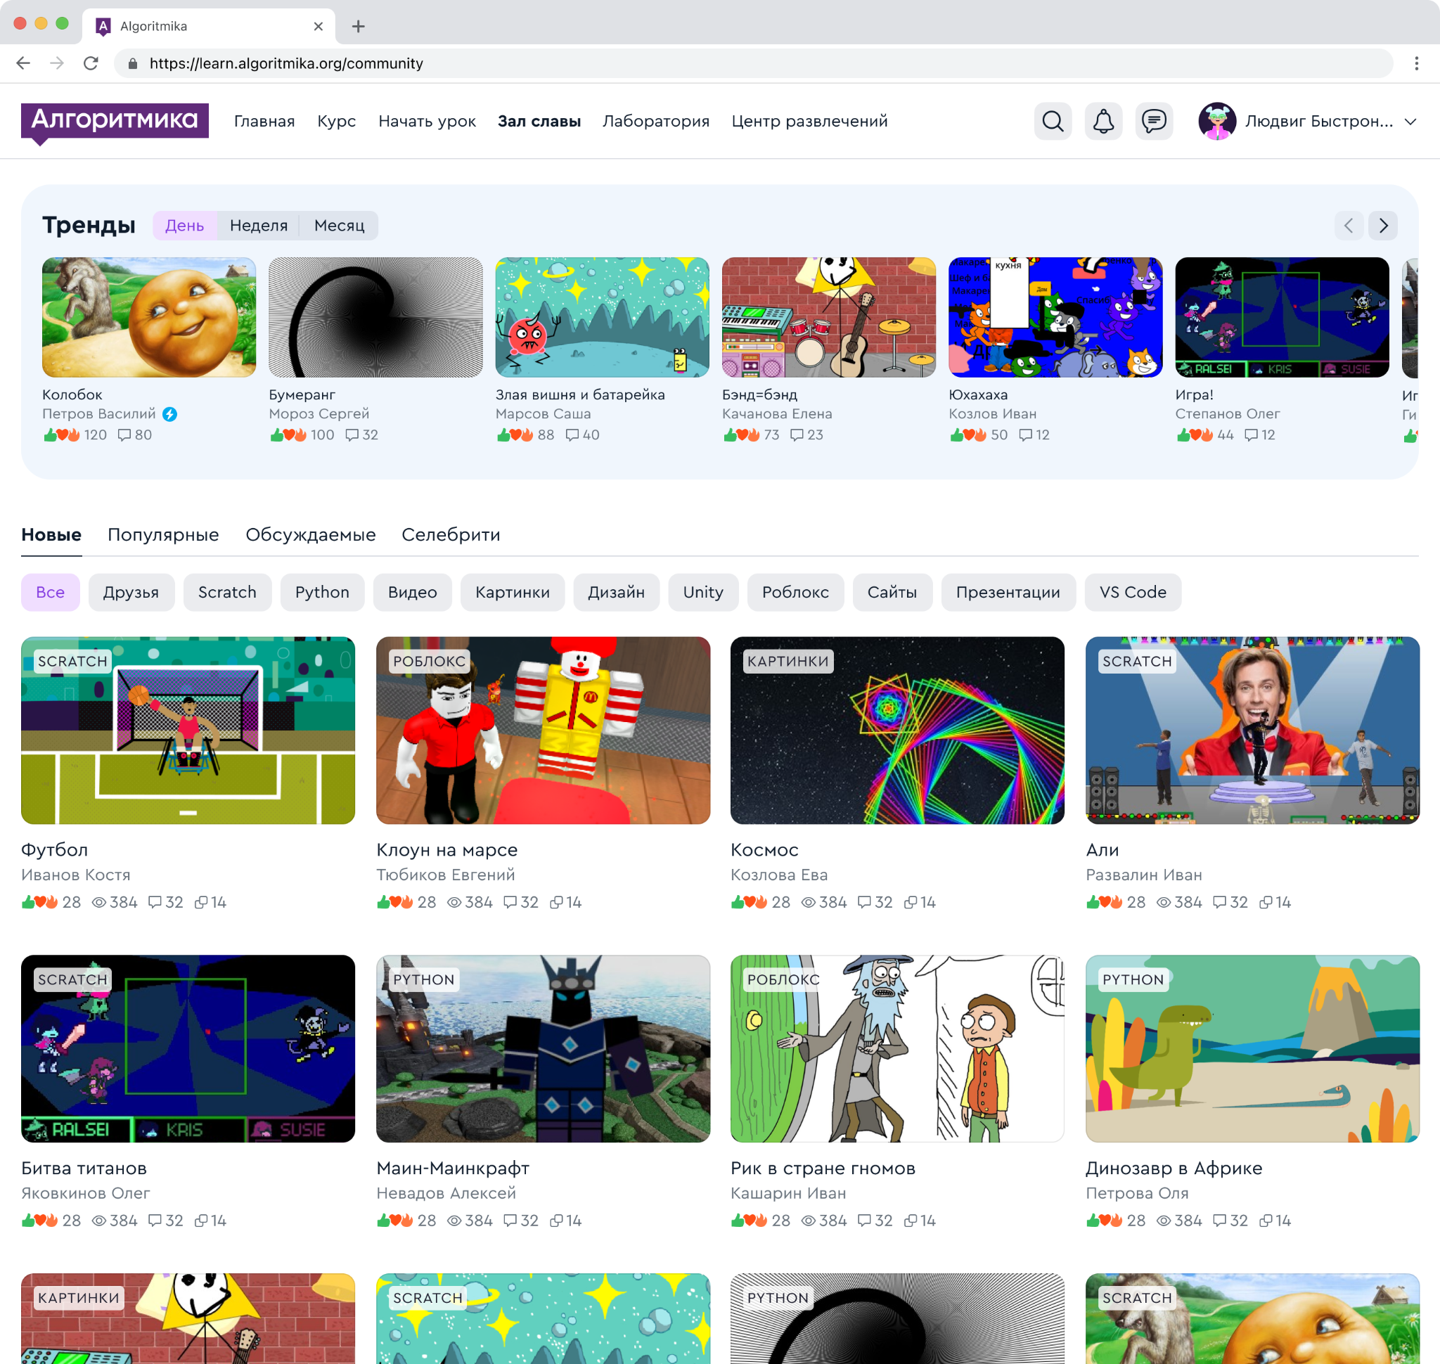
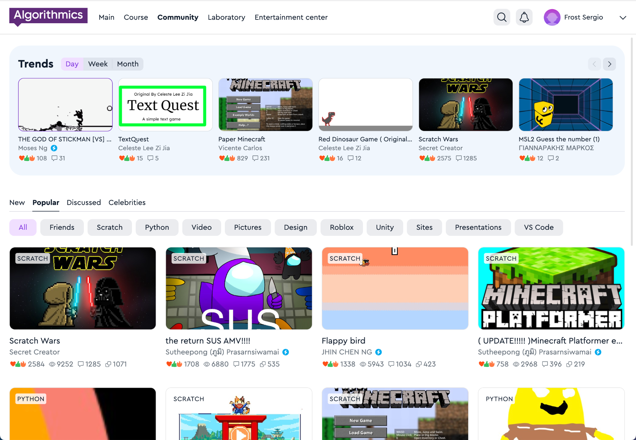
Hall of Fame
A space where our guys share projects, games, and ideas with each other.
In the Hall of Fame, the guys communicate and compete with each other
Hall of Fame

Slide 63
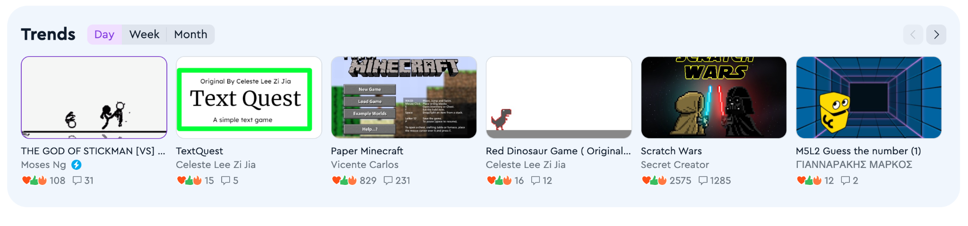
Trends
A block with new projects that are gaining popularity. The projects in this block help to understand what is happening in the Hall of Fame.
The trends reflect the projects that have the most likes and comments per day, week or month.
Hall of Fame

Slide 64
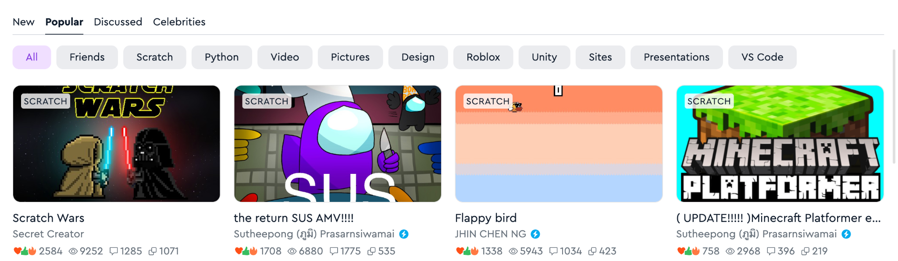
Viewing projects
Projects are displayed by newness, popularity and number of comments, and you can also view projects of "Celebrities", friends, and projects on individual subjects
Hall of Fame

Slide 65
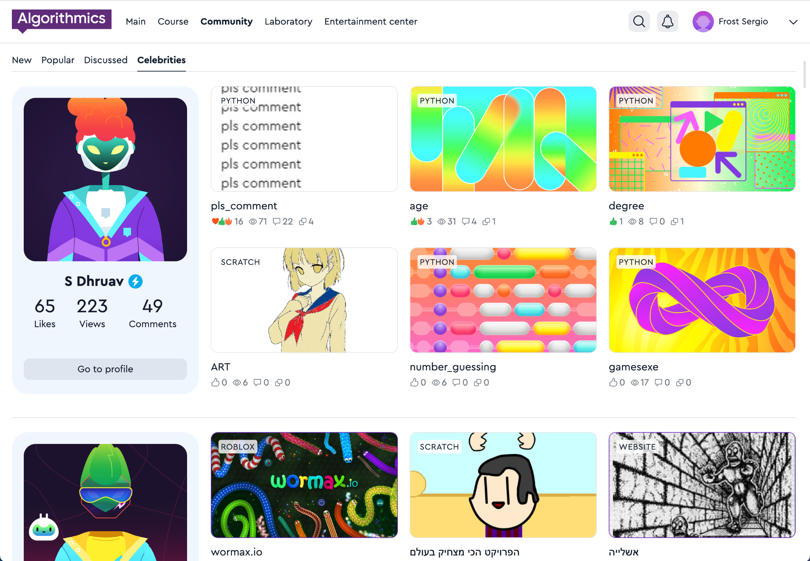

Celebrity
Students who make cool projects and win competitions receive a special status: "Celebrity".
A student who has received celebrity status receives a blue badge
Hall of Fame

Slide 66
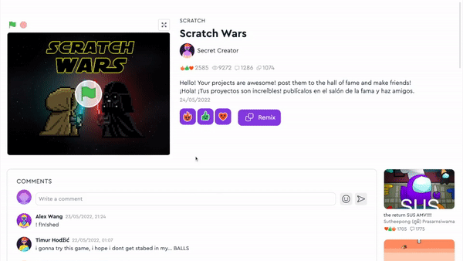
Projects
See the work of other students, play games.
Put reactions, share comments and discuss projects.
Hall of Fame

Slide 67
Hall of Fame rules
When you publish projects or write comments, make sure that you don't break the rules:
😇 | Politeness Do not scold or insult other students.
🤗 | Honesty Do not publish false information about events or people.
🕊 | Peace and friendship Don't add scenes of violence or crimes to your projects.
🚫 | No prohibited materials Do not publish indecent pictures, videos, text, etc.
For violating the rules, your access to the Hall of Fame will be restricted:
— for one week for the first violation,
— for two weeks for the second violation,
— for one month for the third and next violations, and we will also write to parents
Hall of Fame

Slide 68
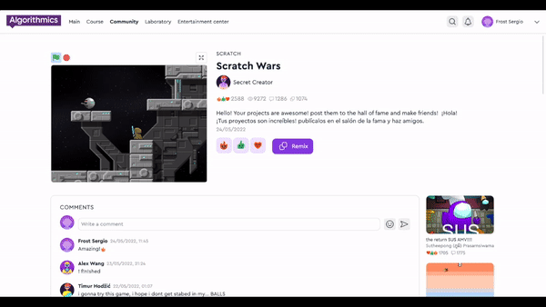

Full-screen project
It's easier to interact with projects if they are open in full screen mode.
To open the project, click on the arrow icon
Hall of Fame

Slide 69
Messages from the teacher and projects of classmates
My class

Slide 70
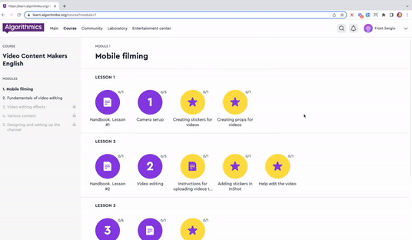
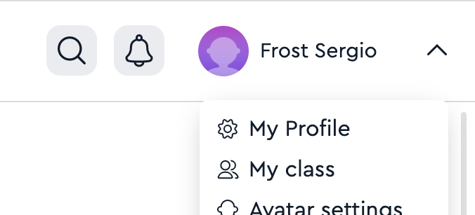

My class
The space in your classroom where you can publish and discuss projects with classmates, and view messages from the teacher.
1. Click on your name in the upper right corner
2. Click on the item
"My class"
Hall of Fame

Slide 71
Storing and viewing your projects
Laboratory

Slide 72


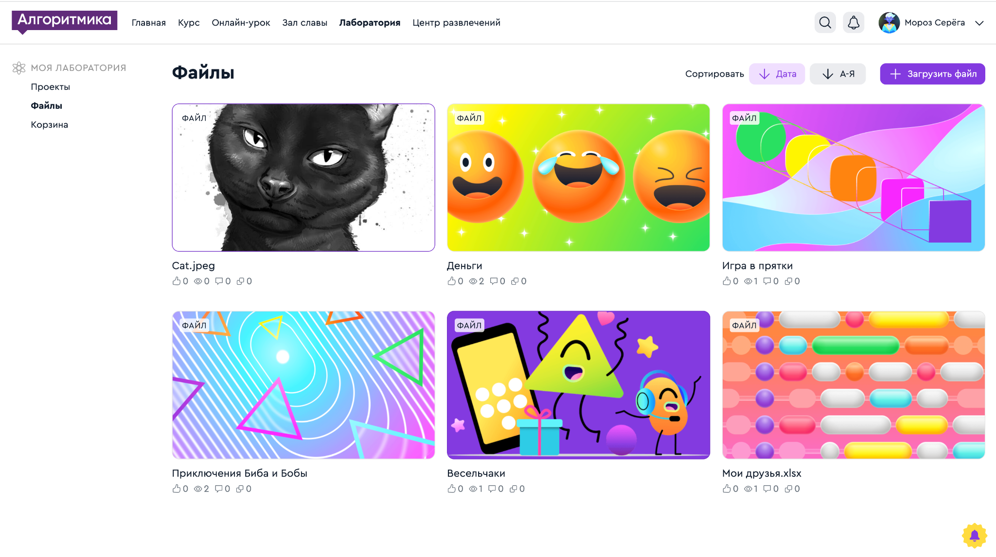
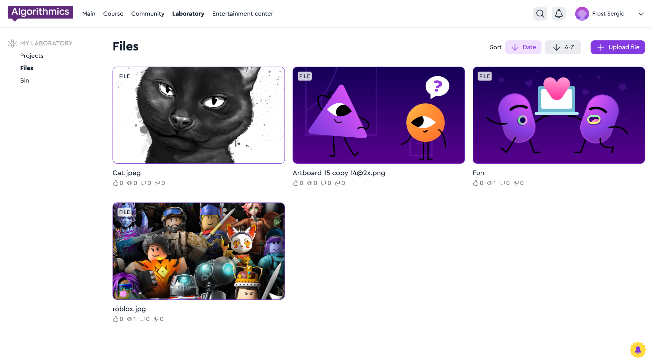
Your solutions are stored in the Lab
The files that you uploaded to the task on the platform go to the "Lab" on the "Files" tab.
Hall of Fame

Slide 73
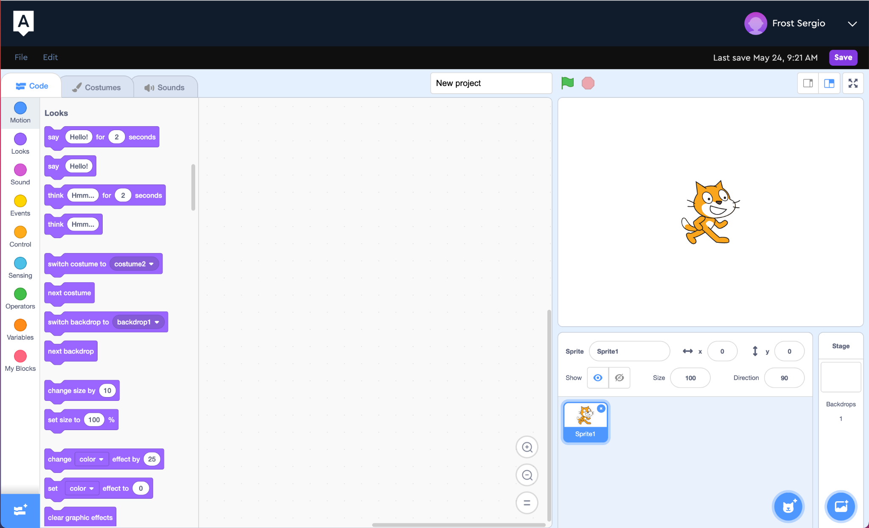
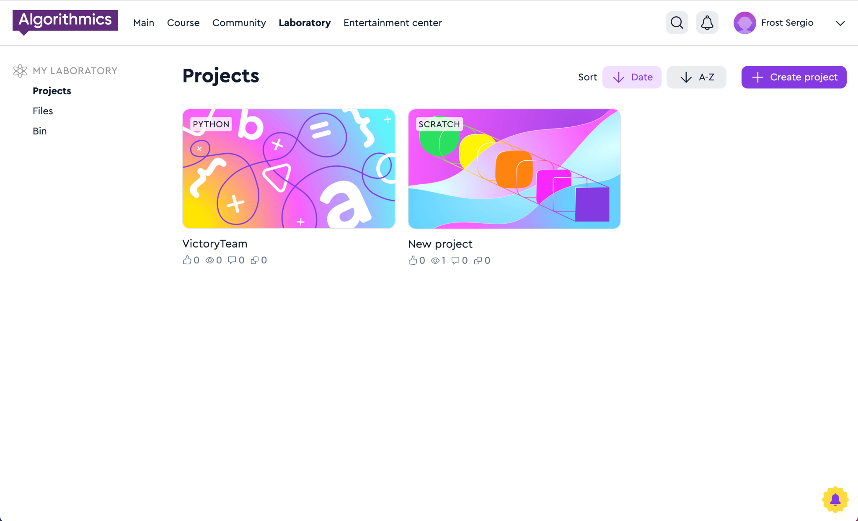
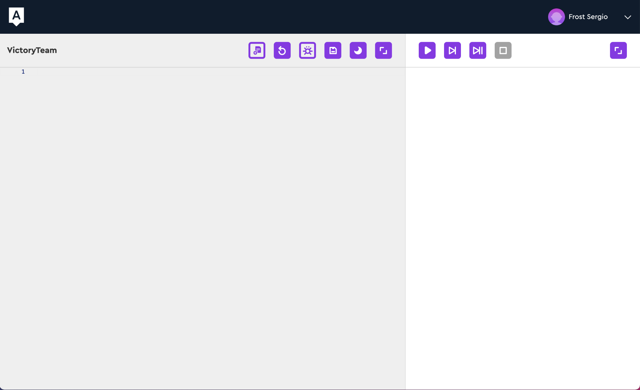
Your solutions are stored in the Lab
Scratch and Python solutions go to the "Lab" on the "Projects" tab immediately after saving.
Hall of Fame

Slide 74
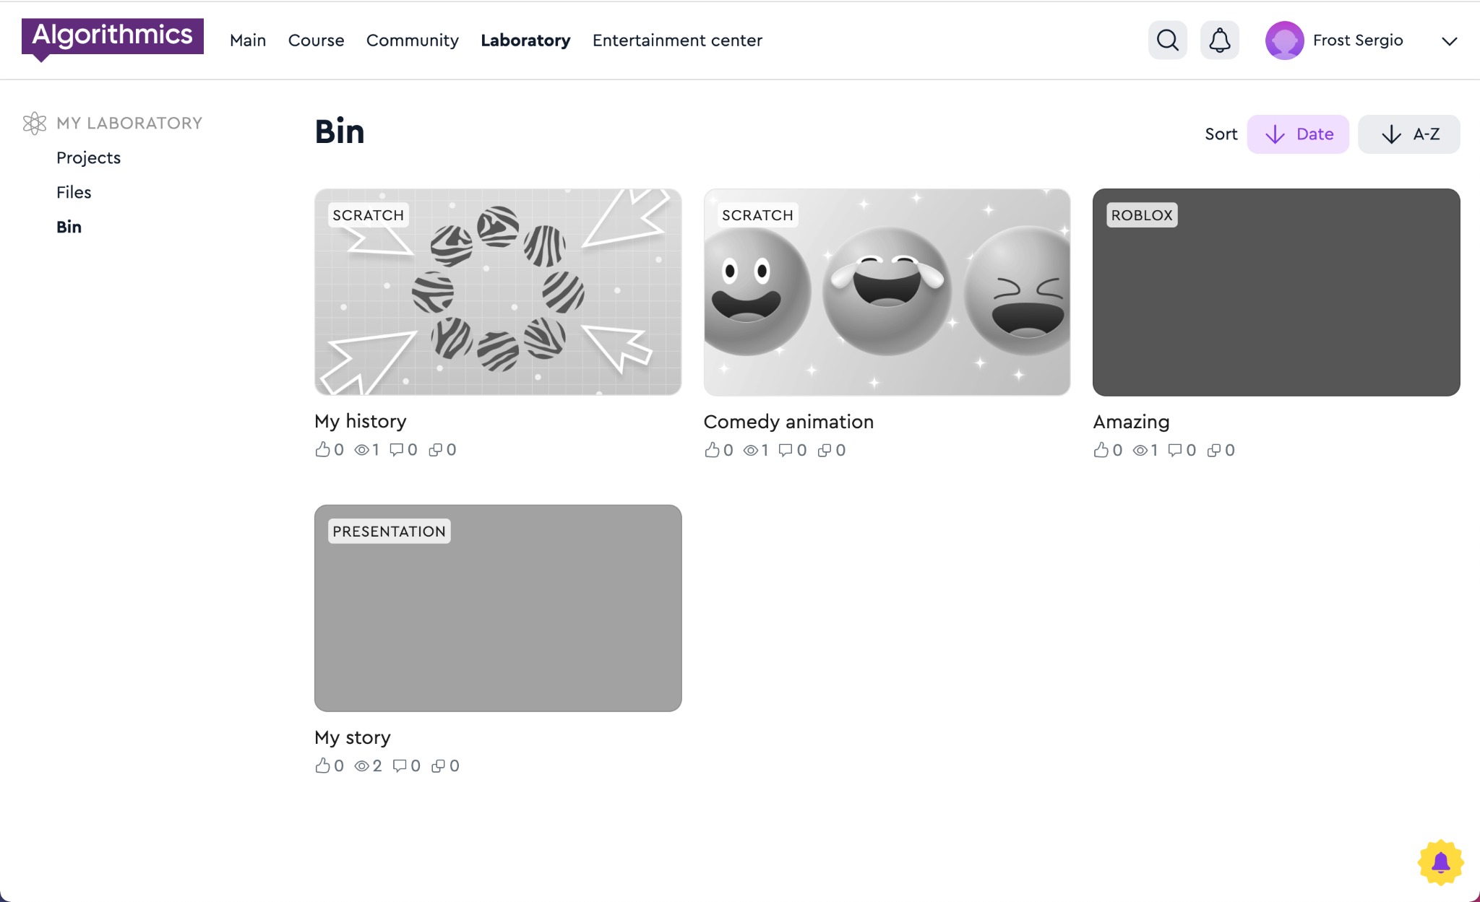
Deleted projects end up in the "Trash"
Hall of Fame

Slide 75
Publishing Python projects
Laboratory

Slide 76
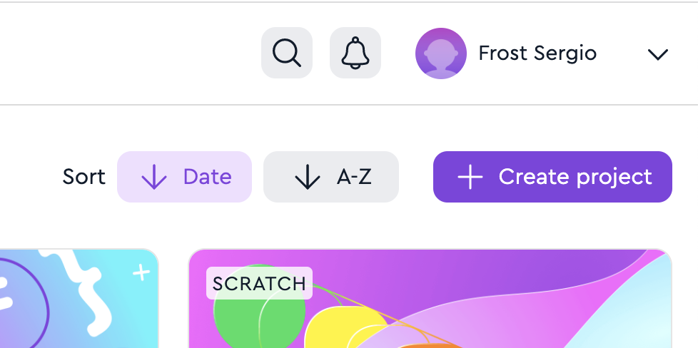
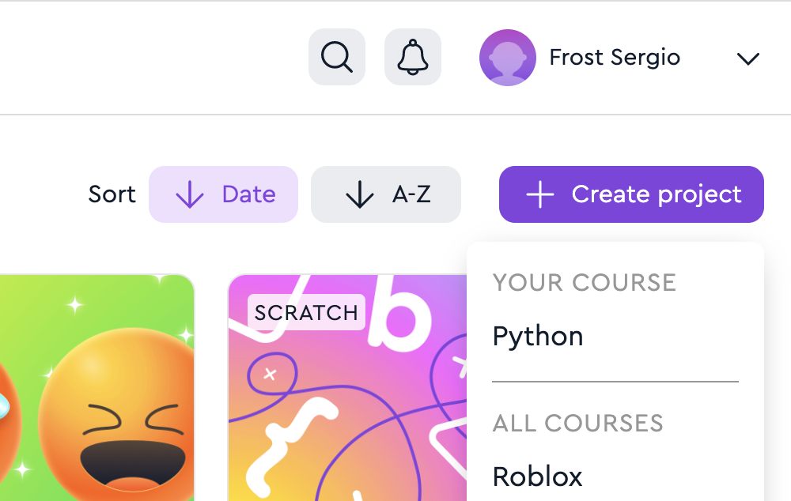
Create a project in the Lab
1. Go to the "Laboratory" page
2. Click on the button "+ Create project" → Python
Laboratory

Slide 77
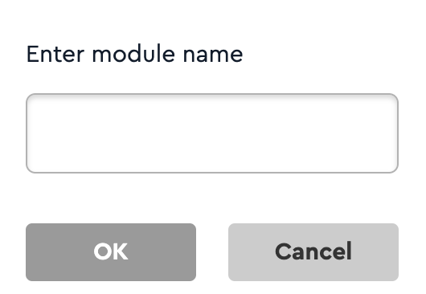
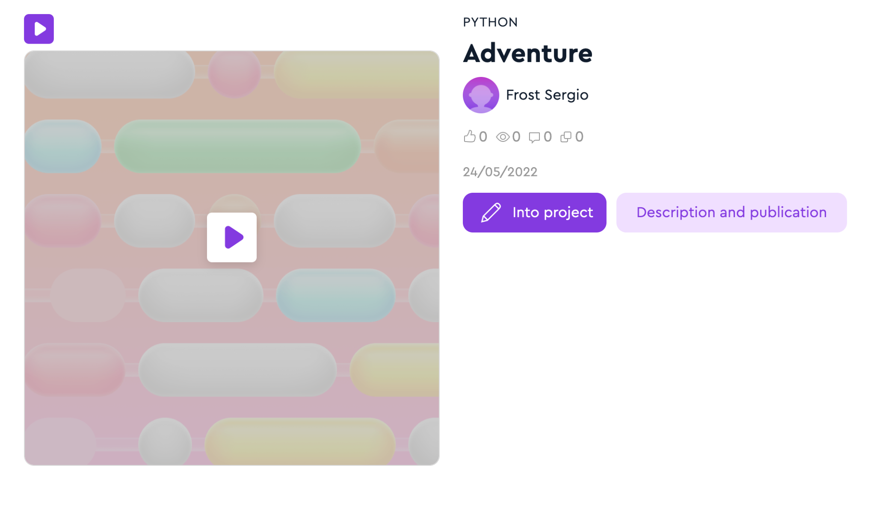
Add a name
3. Enter the project name Use only Latin letters, numbers and the sign "_" The name should not be the same as other names of projects on Python
4. Click "Description and publication"
Laboratory

Slide 78
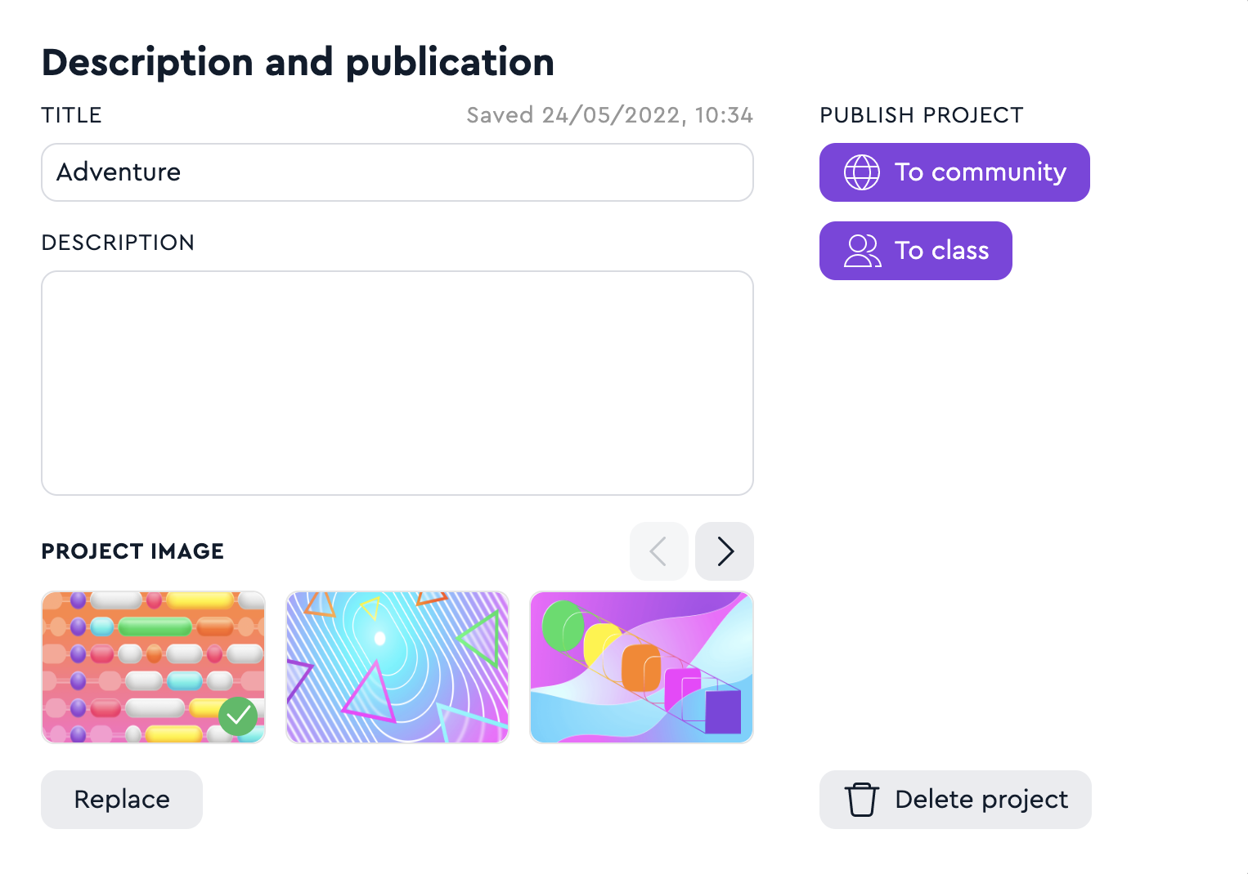
Enter a description and publish
5. Enter the name and description
6. Select and upload an image
7. Publish your project to the Hall of Fame or Class
Laboratory

